Slide 1

SEMANTIC SEARCH ENGINE
BY-
TEAM ID– T211066
CH. NIKHITHA REDDY(IN1240295)
A. KISHORE REDDY(IN1240298)

Slide 2
Objective
To Develop an advanced search engine algorithm that efficiently retrieves subtitles based on user queries, with a specific emphasis on subtitle content. The primary goal is to leverage natural language processing and machine learning techniques to enhance the relevance and accuracy of search results.

Slide 3
Introduction
Craft an innovative search engine algorithm that swiftly and accurately retrieves subtitles based on user queries, prioritizing the content of the subtitles. Employ advanced natural language processing and machine learning techniques to optimize search result relevance and accuracy. This cutting-edge approach ensures an enhanced user experience and seamless access to relevant subtitle content.

Slide 4
Key word based Search Engine
A keyword-based search engine allows users to input specific words or phrases into a search bar to find relevant information from a database or the internet. Using algorithms, it matches these keywords with indexed content, ranks results based on relevance, and displays them in a list format. Examples include Google, Bing, and Yahoo, which help users find information quickly by entering relevant keywords.

Slide 5
Semantic based Search Engine
A semantic-based search engine is a system that retrieves information from a database or the web based on the meaning or context of the user's query rather than just matching keywords. It utilizes natural language processing (NLP) and semantic analysis techniques to understand the intent behind the query and deliver more relevant results. By analyzing the semantics of words and phrases, as well as their relationships, semantic search engines can provide more accurate and contextually appropriate search results compared to traditional keyword-based approaches.

Slide 6
Preprocessing Data
The dataset contains nearly 82000 rows, We extracted 30% of the data and done preprocessing. It involves removing the special characters, punctuations , tokenizing sentences into words, removing links(urls), numbers, timestamps , stops words, converting to lower case and converting into root words using Lemmatization. Additionally, handling missing values and standardizing text formats .

Slide 7
TFIDF Vectorizer
TF-IDF vectorizer, short for Term Frequency-Inverse Document Frequency vectorizer, is a feature extraction technique widely used in natural language processing and information retrieval tasks. It transforms a collection of text documents into a numerical matrix representation based on the frequency of terms in the documents and their importance in distinguishing documents from each other. Using fit_transform() method , it learns from the subtitle content. This vectorizer converts text data into vectors.

Slide 8
Cosine similarity Matrix
The cosine similarity matrix calculates the pairwise cosine similarity between vectors in a dataset. It measures the cosine of the angle between two vectors, providing a measure of similarity irrespective of their magnitude.
In natural language processing, cosine similarity is often used to compare the similarity between text documents represented as numerical vectors, such as TF-IDF vectors. A cosine similarity matrix enables us to compare each document to every other document in the dataset, helping to identify similar documents based on their content. Higher cosine similarity scores indicate greater similarity between vectors, while lower scores suggest dissimilarity.

Slide 9
Building Streamlit web app
To make the search engine more interactive, we have developed a streamlit webapp .It allows the user to enter the query , which is compared against the subtitle corpus to find similar subtitles. The top 5 matching subtitles are displayed to the user on the page.

Slide 10
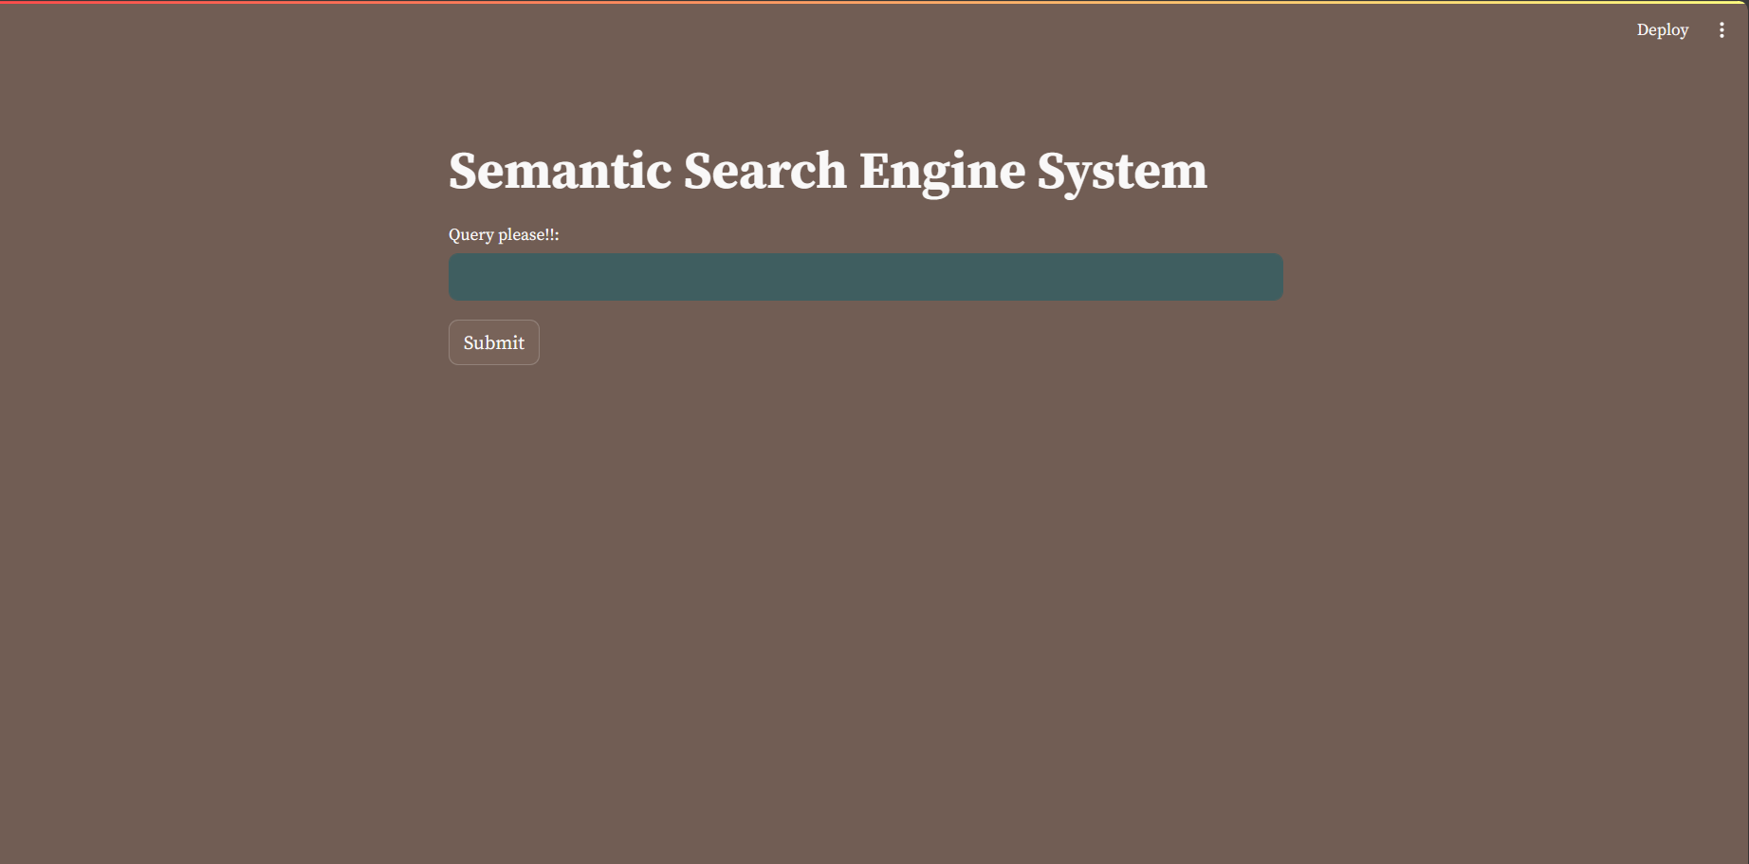

Slide 11
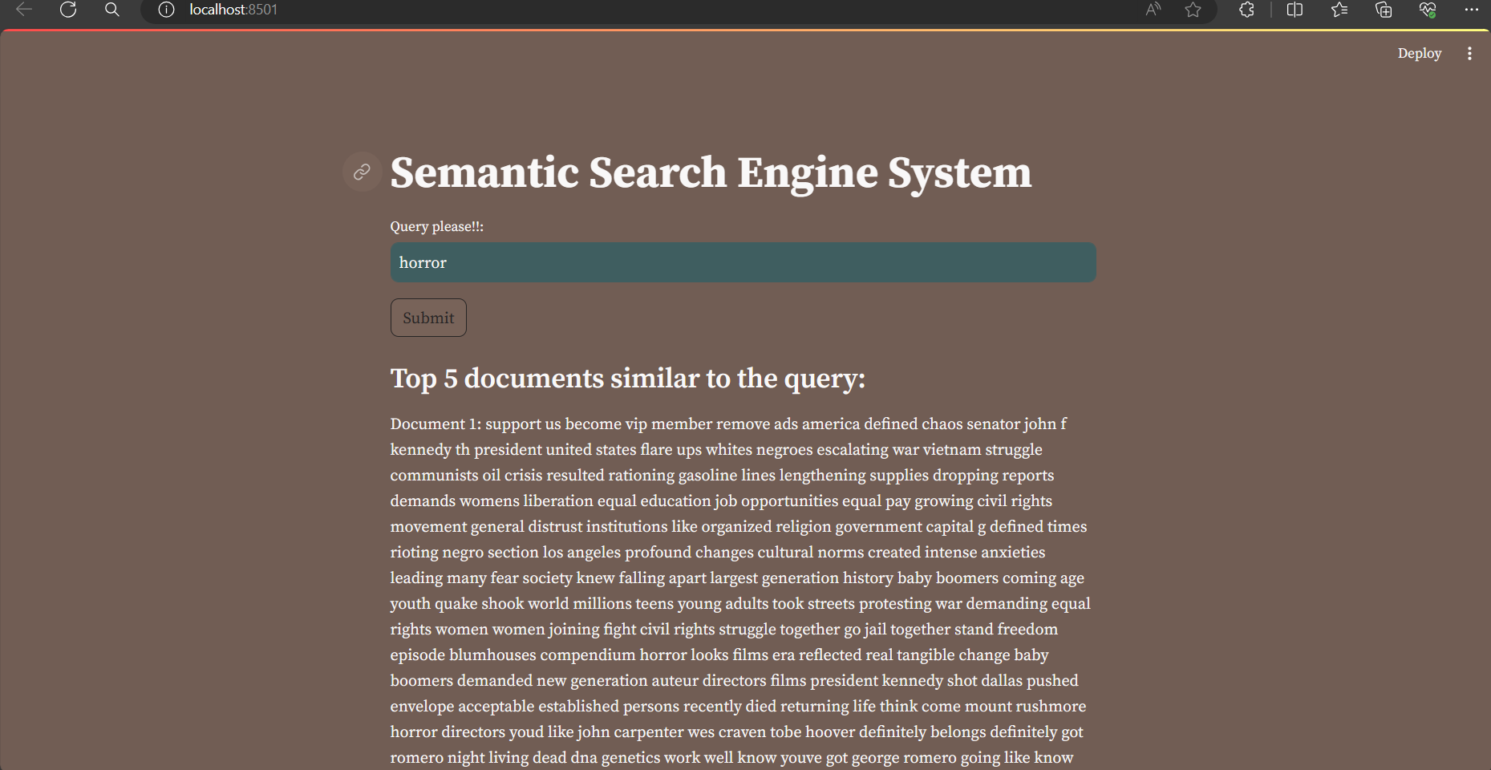

Slide 12

THANK YOU

